Slide 1

Wireshark
Yuvapriya S
2022503552

Slide 2
Problem Statement
Packet Sniffing and Data Leakage Detection Analyze network traffic to identify sensitive information transmitted in plaintext, such as passwords, credit card numbers, or personal data.

Slide 3
Aim
Analyze network traffic to detect plaintext transmission of sensitive data.
Implement packet sniffing techniques for monitoring and identifying potential data leaks.

Slide 4
Installation and Issues
Download and Install Wireshark & Npcap
Visit the official Wireshark website and download the latest version compatible with your operating system.
During the installation process, ensure that Npcap is selected, as it is required for packet capturing.
Verifying Npcap Installation and Diagnosing Issues
If Npcap fails to function properly, it may be due to a driver issue.
To verify its status, open the Command Prompt with administrative privileges (Run as Administrator) and execute the following command: net start npcap
If the service is not running or an error is displayed, consider reinstalling Npcap or updating the network drivers.

Slide 5
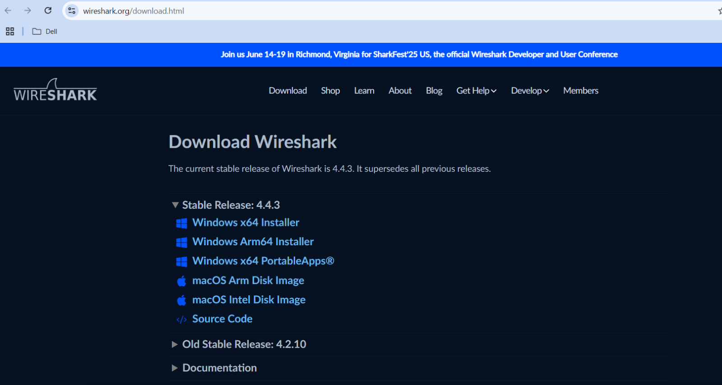

Slide 6
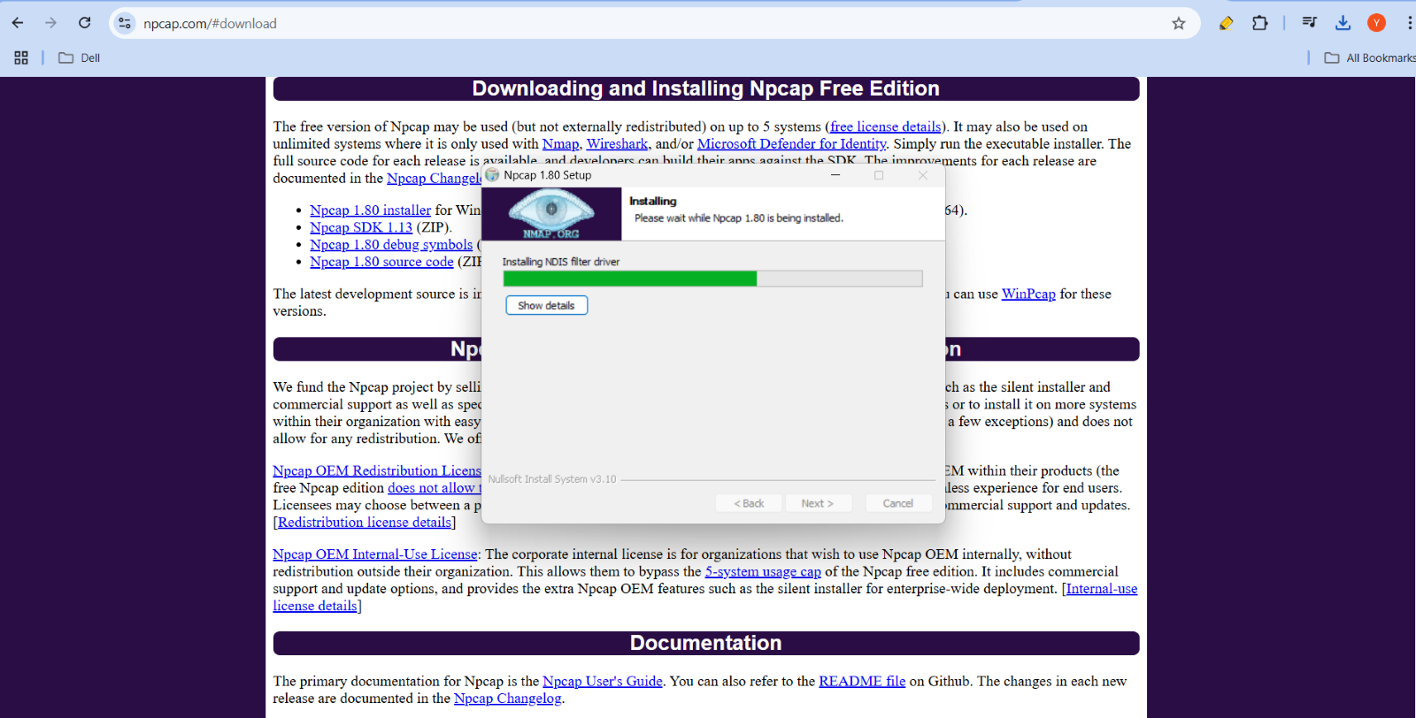

Slide 7
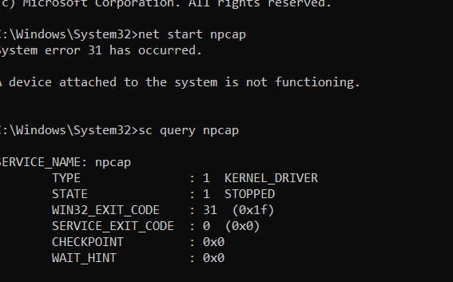

Slide 8
Uninstalling issues
Uninstall Npcap First
Before removing Wireshark, Npcap should be uninstalled first to prevent driver-related issues.
Go to Control Panel → Programs and Features, find Npcap, and uninstall it.
Handling Persistent Npcap Driver Issues
If Npcap fails to uninstall due to driver conflicts, manually stop its processes:
Open Task Manager (Ctrl + Shift + Esc).
End any processes related to Npcap or Wireshark.
Try uninstalling again.

Slide 9
Force Deletion (If Uninstallation Fails)
Open the Command Prompt as Administrator and run: net stop npcap
Then, attempt to uninstall it again from Control Panel.
Manual Removal (As a Last Resort)
If Npcap still does not uninstall, delete its installation folder manually:
Navigate to: C:\Program Files\Npcap
Delete the entire folder.
After removing Npcap, proceed with Wireshark uninstallation.

Slide 10
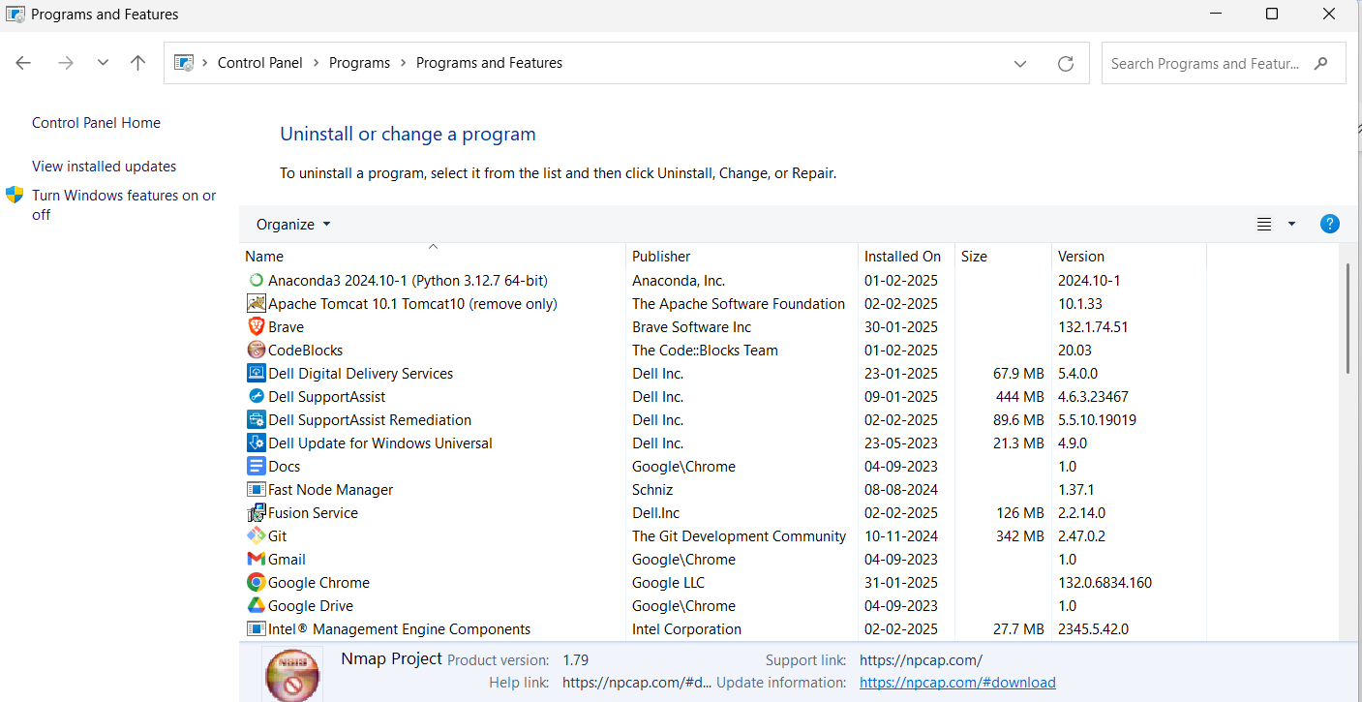

Slide 11
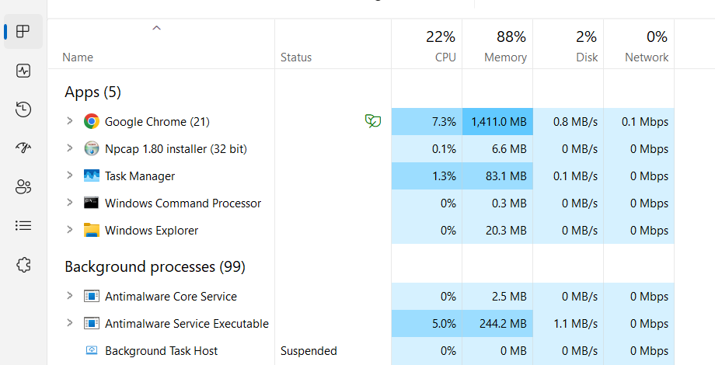

Slide 12
Website Accessing
For secure websites, it will not decrypt or show any sensitive information
For insecure websites or vulnerable websites, we can easily take the login credentials and user details inside the website
https://drive.google.com/file/d/1osRE8WF9uNGZRt9iS1S7gUdRVBV1ONFs/view?usp=sharing
https://drive.google.com/file/d/122QEJdhyZjA09mdifd6K1ZML4ffidga-/view?usp=sharing

Slide 13
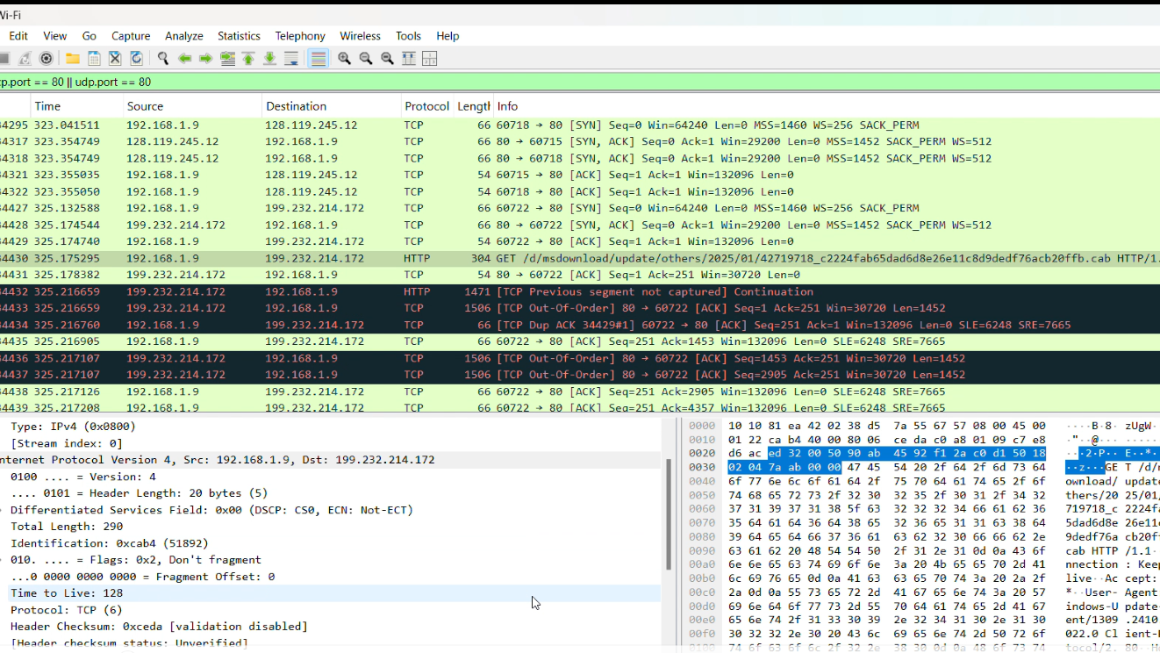

Slide 14
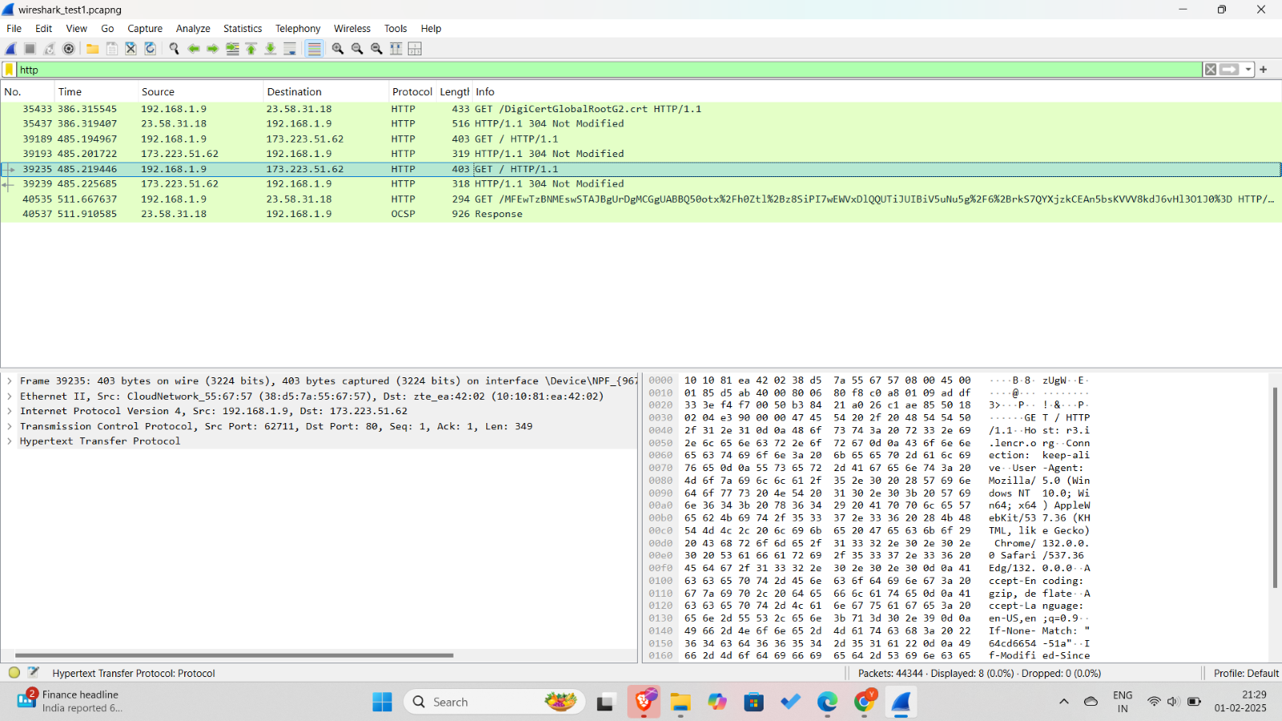

Slide 15
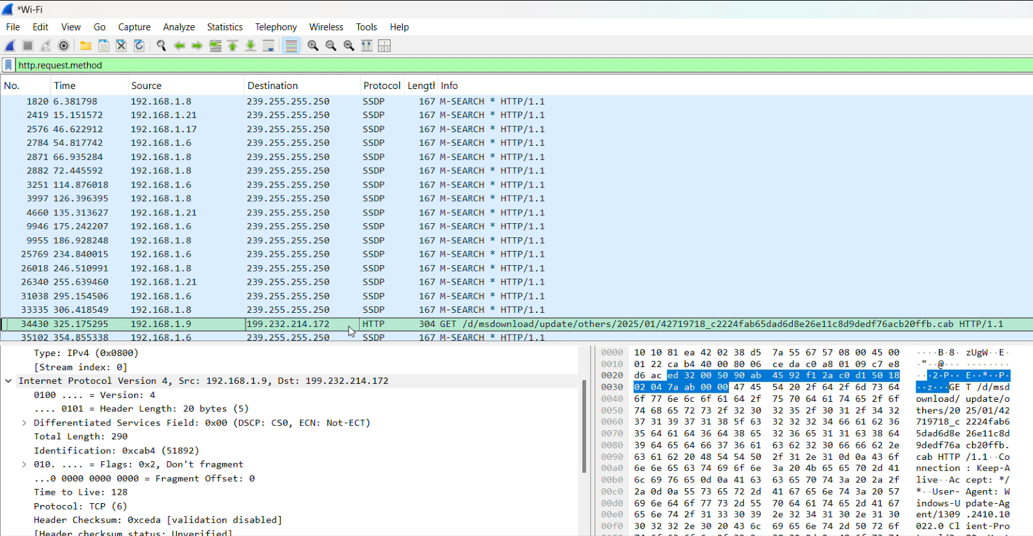

Slide 16
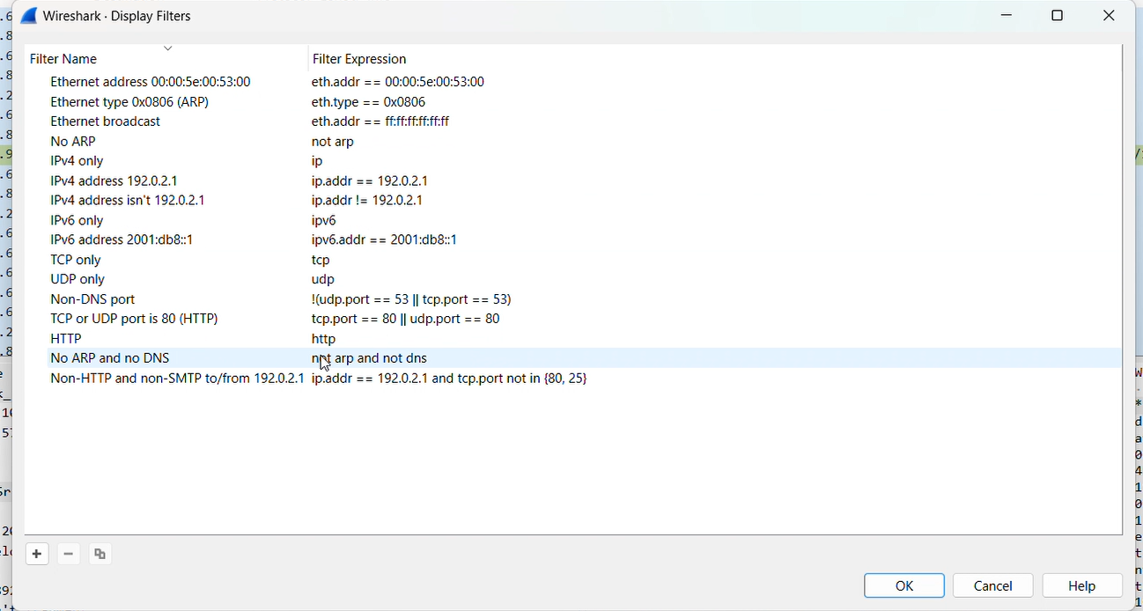

Slide 17
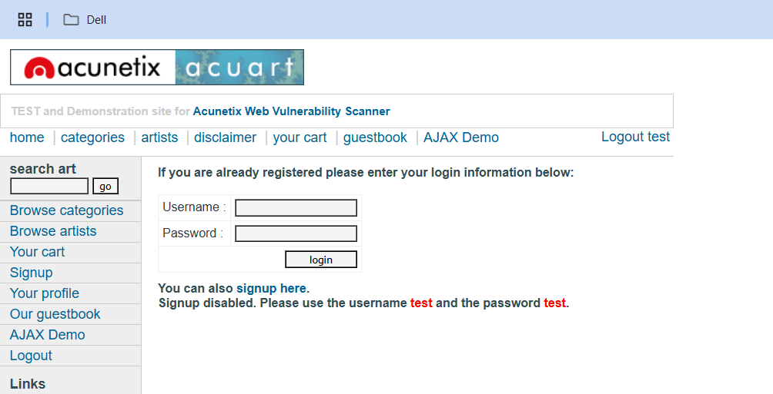

Slide 18
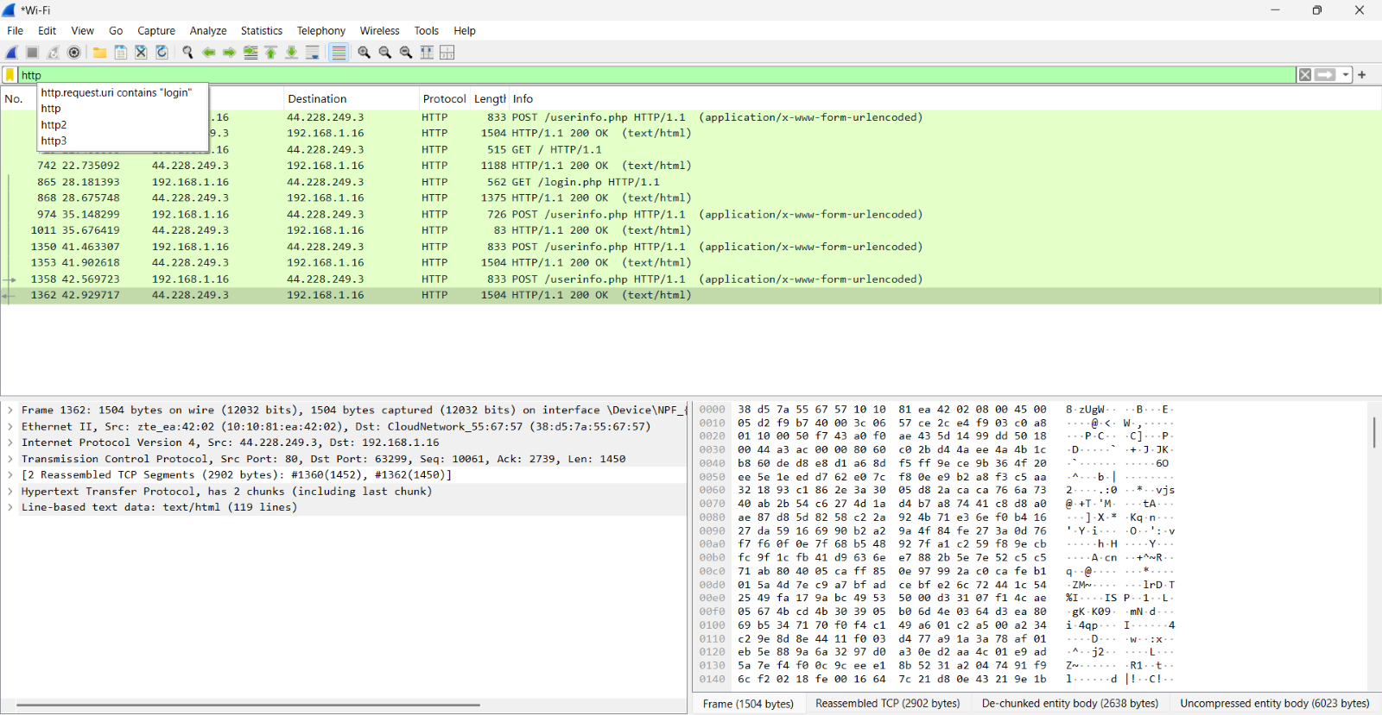

Slide 19
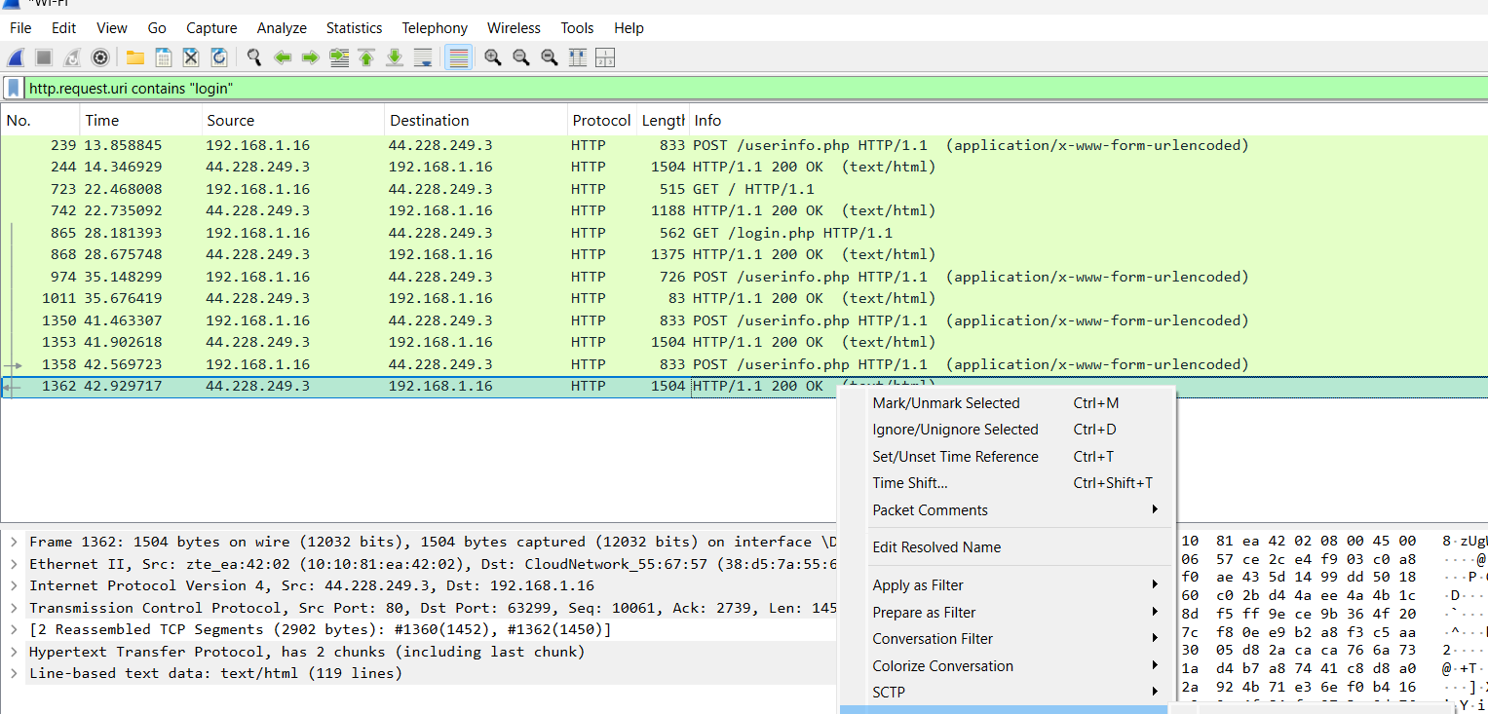

Slide 20
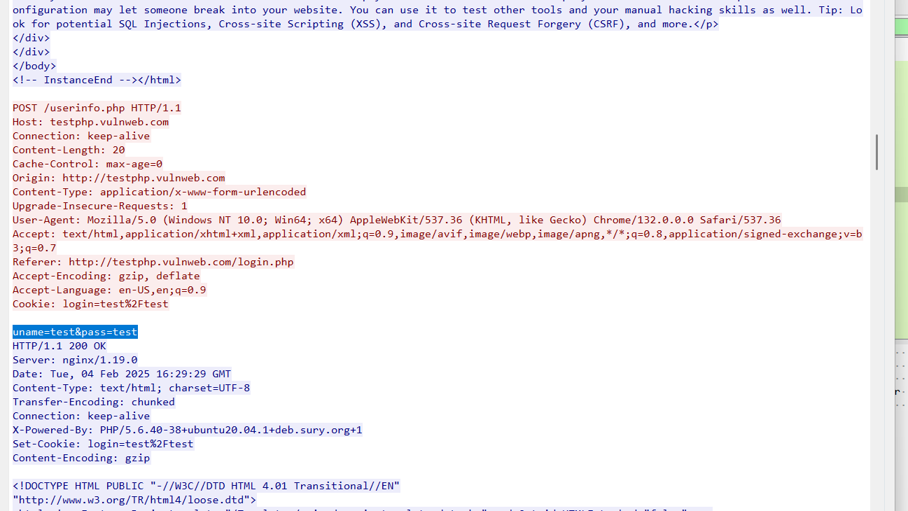

Slide 21
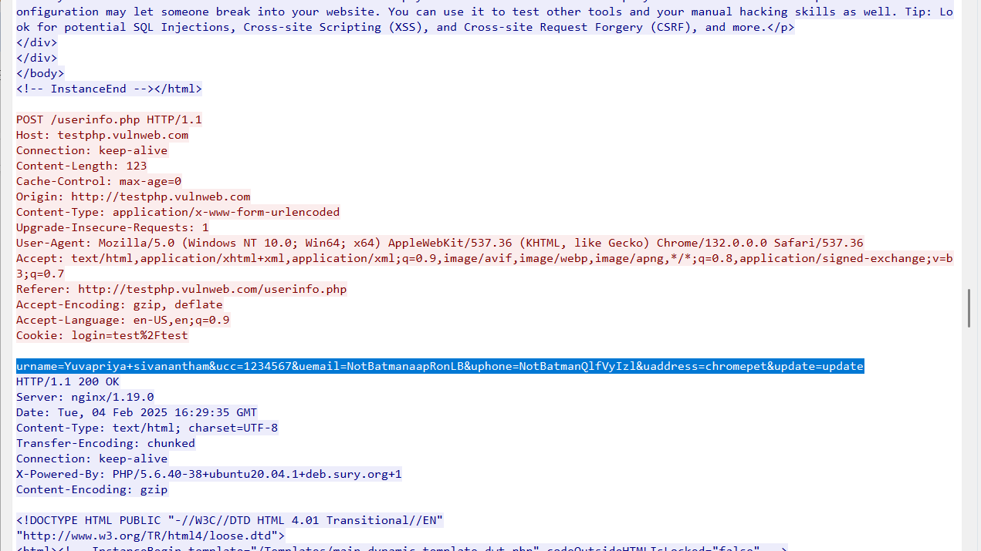

Slide 22
References
https://www.wireshark.org
https://www.npcap.org
https://wiki.wireshark.org

Slide 23

Thank you
By Yuvapriya S

